Slide 1
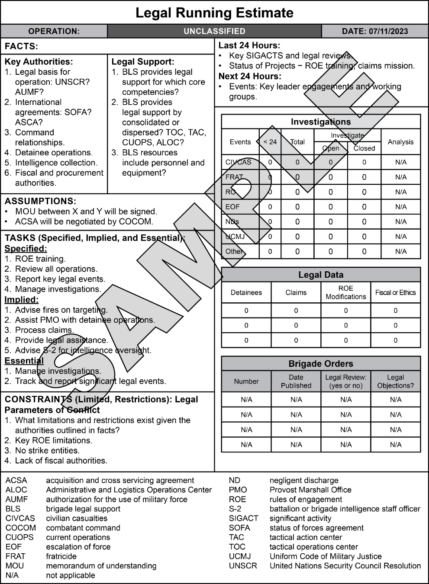
FM 3-84, Legal Support to Operations
Army’s Primary Source of Doctrine for Legal Support
Updated in September 2023
Numbering changed from FM 1-04 to FM 3-84 to conform with JP 3-84 and add emphasis of role of JAs in operations
Added a practical legal running estimate appendix based on feedback from combat training centers
Incorporated changes to FM 3-0 with a focus on multidomain operations and emphasis on early integration of Judge Advocates in planning
Key Point: Legal support crosses all Warfighting Functions; staff planners must make allowances for legal assets at various command posts and nodes

